Slide 1


JAVA INTERVIEW BOOTCAMP
Lecture 10

Slide 2

Today’s Agenda
Operators
Types Of Operators
Important Rules Regarding Evaluation Order
Examples

Slide 3
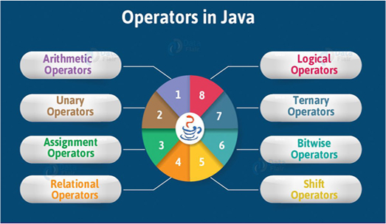
Operators In Java

Slide 4
Precedence Chart
Operator Type | Category | Precedence
Unary | postfix | expr++ expr--
 | prefix | ++expr --expr +expr -expr ~ !
Arithmetic | multiplicative | * / %
 | additive | + -
Shift | shift | << >> >>>
Relational | comparison | < > <= >= instanceof
 | equality | == !=
Bitwise | bitwise AND | &
 | bitwise exclusive OR | ^
 | bitwise inclusive OR | |
Logical | logical AND | &&
 | logical OR | ||
Ternary | ternary | ? :
Assignment | assignment | = += -= *= /= %= &= ^= |= <<= >>= >>>=

Slide 5
Most Important For Interview
Following are the minimum operators we must know for any Java Interview
Assignment Operators
=, +=, -=, *=, /=,%= Assign value to a variable
Arithmetic Operators
+, -, *, /, %, ++, -- Add, subtract, multiply, divide, and modulus primitives
Relational Operators
<, <=, >, >=, ==, != Compare primitives
Logical Operators Apply NOT , AND and OR
!, &&, ||

Slide 6
Order Of Evaluation
To understand the result returned by an operator, it is important to understand the evaluation order of its operands.
In general, the operands of operators are evaluated from left to right.
The evaluation order also respects any parentheses, and the precedence and associativity rules of operators.

Slide 7
Order Of Evaluation
Rule 1: Left-Hand Operand Evaluation First
The left-hand operand of a binary operator is fully evaluated before the right-hand operand is evaluated.

Slide 8
Order Of Evaluation
What is the output ?
int b = 10; System.out.println((b=3) + b);
6
The evaluation proceeds as follows:
(b=3) + b 3 + b b is assigned the value 3 3 + 3 6

Slide 9
Order Of Evaluation
Rule 2 :Operand Evaluation before Operation Execution
Java guarantees that all operands of an operator are fully evaluated before the actual operation is performed.

Slide 10
Order Of Evaluation
In the expression a + b * c, the operand a will always be fully evaluated before the operand b, which will always be fully evaluated before the operand c.
However, the multiplication operator * will be applied before the addition operator +, respecting the precedence rules.

Slide 11
Order Of Evaluation
class Test {
public static int a(){
System.out.println("a");
return 2;
}
public static int b(){
System.out.println("b");
return 3;
}
public static int c(){
System.out.println("c");
return 4;
}
public static void main(String[] args) {
System.out.println(a() + b() * c());
}
}
Output:
a
b
c
14
Reason:
Because, regardless of the order in which operators are needed and used in the equation, they're still evaluated left to right.

Slide 12
Order Of Evaluation
class Test {
static int x;
public static int a(){
System.out.println("a");
x=10;
return x;
}
public static int b(){
System.out.println("b");
return x;
}
public static int c(){
System.out.println("c");
return x;
}
public static void main(String[] args) {
System.out.println(a() + b() * c());
}
}
Output:
a
b
c
110

Slide 13
Order Of Evaluation
Output:
x=11,y=21,z=241
class Test{
public static void main(String[] args) {
int x=10,y=20,z;
z=x++ + ++y * x;
System.out.println("x="+x+",y="+y+",z="+z);
}
}

Slide 14
Order Of Evaluation
Output:
x=12,y=21,z=262
class Test{
public static void main(String[] args) {
int x=10,y=20,z;
z=x++ + ++y * ++x;
System.out.println("x="+x+",y="+y+",z="+z);
}
}

Slide 15
Order Of Evaluation
Output
Evaluation order of operands: 2 + 3 * 4 14
import static java.lang.System.out; public class EvalOrder{ public static void main(String[] args){ int j = 2; out.println("Evaluation order of operands:"); out.println(eval(j++, " + ") + eval(j++, " * ") * eval(j, "\n")); int i = 1; out.println("Evaluation order of arguments:"); add3(eval(i++, ", "), eval(i++, ", "), eval(i, "\n")); } public static int eval(int operand, String str) { out.print(operand + str); return operand; } public static void add3(int operand1, int operand2, int operand3) { out.print(operand1 + operand2 + operand3); } }
Evaluation order of arguments: 1, 2, 3 6

Slide 16
Arithmetic Operators
Operator | Purpose | Usage | Answer
+ | Addition | 12 + 10 | 22
- | Subtraction | 19 – 29 | -10
* | Multiplication | 101 * 45 | 4545
/ | Division (quotient) | 10 / 6 10.0 / 6.0 | 1 1.6666666666666667
% | Modulus (remainder in division) | 10 % 6 10.0 % 6.0 | 4 4.0
++ | Unary increment operator; increments value by 1 | int x=10; ++x; | 11
-- | Unary decrement operator; decrements value by 1 | int x=10; --x; | 9

Slide 17
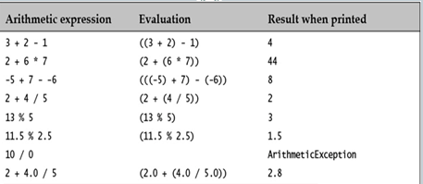
Arithmetic Operators

Slide 18
Six Special Cases
Case 1:
System.out.println(10/0);
ArithmeticException
Case 2:
System.out.println(10/0.0);
Infinity
Case 3:
System.out.println(0/10);
0
Case 4:
System.out.println(0.0/10);
0.0
Case 5:
System.out.println(0/0);
ArithmeticException
Case 6:
System.out.println(0/0.0);
NaN

Slide 19
Unary Operator
The unary operators have the highest precedence of all the arithmetic operators.
The unary operator - negates the numeric value of its operand.
int value = - -10; // (-(-10)) is 10
Notice the blank needed to separate the unary operators; otherwise, these would be interpreted as the decrement operator --, which would result in a compile-time error because a literal cannot be decremented.

Slide 20
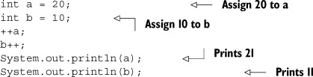
Unary Operator
The operators ++ and -- are also unary operators as they too work with a single operand.
They’re used to increment or decrement the value of a variable by 1.

Slide 21
Very Important Point !
Numeric Promotions in Arithmetic Expressions
Unary numeric promotion is applied to the single operand of the unary arithmetic operators - and +.
When a unary arithmetic operator is applied to an operand whose type is narrower than int, the operand is promoted to a value of type int, with the operation resulting in an int value.
byte b = 3; // OK. int literal in range. Narrowing conversion.
b=-b; // Error ! Lossy conversion
b = (byte) -b; // OK Cast applied on assignment.

Slide 22
Very Important Point !
Binary numeric promotion is applied to operands of binary arithmetic operators.
It’s application leads to type promotion for the operands
The result is of the promoted type, which is always type int or wider.

Slide 23
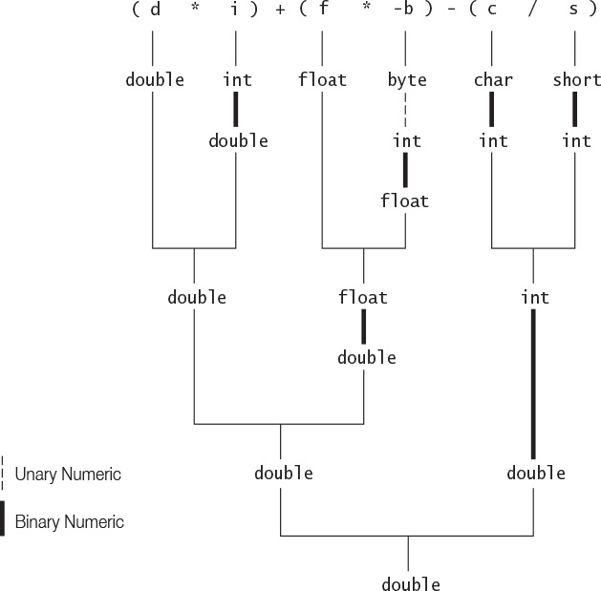
Very Important Point !

Slide 24
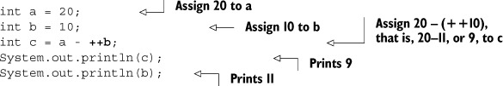
Another Important Point !
When a unary operator is used in an expression, it’s placement with respect to its operand decides whether its value will increment or decrement before the evaluation of the expression or after the evaluation of the expression.

Slide 25
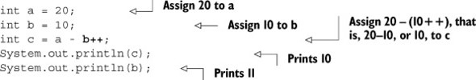
Another Important Point !
When ++ is used in postfix notation with an operand, its value increments after it has been used in the expression:

Slide 26
Another Important Point !
What do you think the output of the following code will be?
int a = 10;
a = a++ + a + a-- - a-- + ++a;
System.out.println(a);
Answer:
32

Slide 27
Explanation
The evaluation of an expression starts from left to right.
For a prefix unary operator, the value of its operand increments or decrements just before its value is used in an expression.
For a postfix unary operator, the value of its operand increments or decrements just after its value is used in an expression

Slide 28
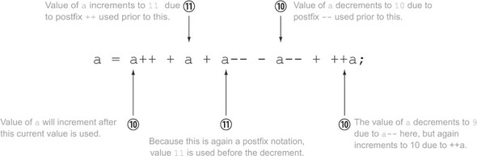
Explanation

Slide 29
Important Question
What do you think the output of the following code will be?
int a = 10;
a = ++a + a + --a - --a + a++;
System.out.println (a);
Answer:
32
Why the last a++ did not retain it’s value ?
a++ is a post increment, so a is assigned the value of a and the ghost variable of a is incremented afterwards making no difference to the real a

Slide 30
Important Question
What do you think the output of the following code will be?
int a=3;
a=a++;
System.out.println(a);
Answer:
3

Slide 31
Important Question
What do you think the output of the following code will be?
int x=5;
x=x++/x++;
System.out.println(x);
Answer:
0

Slide 32
Important Question
What do you think the output of the following code will be?
int x=5;
x= ++x/x++;
System.out.println(x);
Answer:
1

Slide 33
Important Question
What do you think the output of the following code will be?
int x=5;
x= ++x/++x;
System.out.println(x);
Answer:
0

Slide 34
Important Question
What do you think the output of the following code will be?
int x=5;
x= x++/++x;
System.out.println(x);
Answer:
0

Slide 35
Important Question
What do you think the output of the following code will be?
int x=5,y;
y= x++/x++;
System.out.println(x+”,”+y);
Answer:
7,0

Slide 36
Important Question
What do you think the output of the following code will be?
int a=0;
for(int i=0;i<100;i++)
{
a=a++;
}
System.out.println(a);
Answer:
0

Slide 37
Important Question
What do you think the output of the following code will be?
int a=2;
int b=a++ + a++;
int c= ++a + a++ + a++;
System.out.println(a+”,”+b+”,”+c);
Answer:
7,5,16

